Slide 1

Project Title – NETFLIX DATA ANALYSIS
KHUSHI BHARDWAJ
INTERNSHIP_17546440516895be537820f

Slide 2

PROBLEM STATEMENT
Netflix has become one of the most prominent global streaming platforms, continuously expanding its library with a mix of original productions and licensed content. However, with growing competition from platforms like Amazon Prime, Disney+, and regional OTT providers, Netflix must strategically analyze its content catalog to identify strengths, gaps, and opportunities.
The specific problem to be addressed in this project is 'Content Trends Analysis for Strategic Recommendations'. The aim is to uncover how Netflix’s content distribution (Movies vs. TV Shows, genres, and country contributions) has evolved over the years. This will enable the identification of key genres, audience preferences, and strategic insights into global content expansion.

Slide 3
Project Description
This project analyzes the differences in content duration between Movies and TV Shows on Netflix. By extracting and comparing the runtime of Movies (in minutes) and TV Shows (by number of seasons), the project highlights distribution patterns and trends. The goal is to understand how content length varies across formats and to provide insights into Netflix’s content structure using data visualization.

Slide 4

WHO ARE THE END USERS?
  Netflix Content Strategy Team
  Data analysts and data scientists
  Marketing and UX teams
  Production and acquisition team
  Researchers and academics

Slide 5

Technology Used
  Python :core programming language
  Pandas and NumPy : data cleaning and preprocessing
  Scikit-learn :machine learning (model model)
  Matplotlib/seaborn : data visualization nnd feature importance
  Google colab : cloud based environment for running the project
  File handling libraries ; openpyxl(for excel) and built-in csv handling

Slide 6
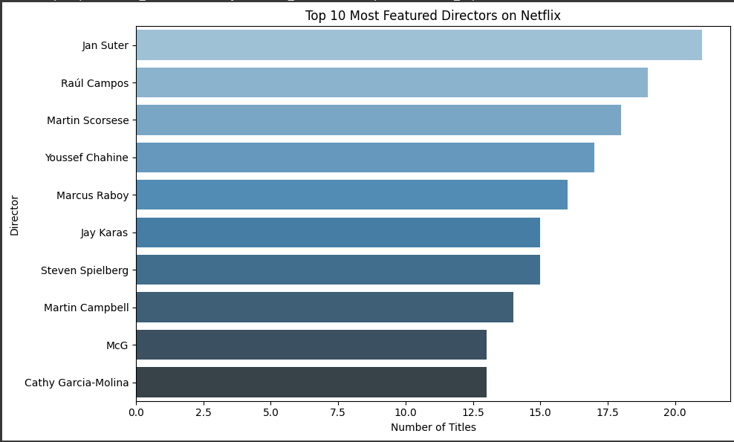
RESULTS1

Slide 7
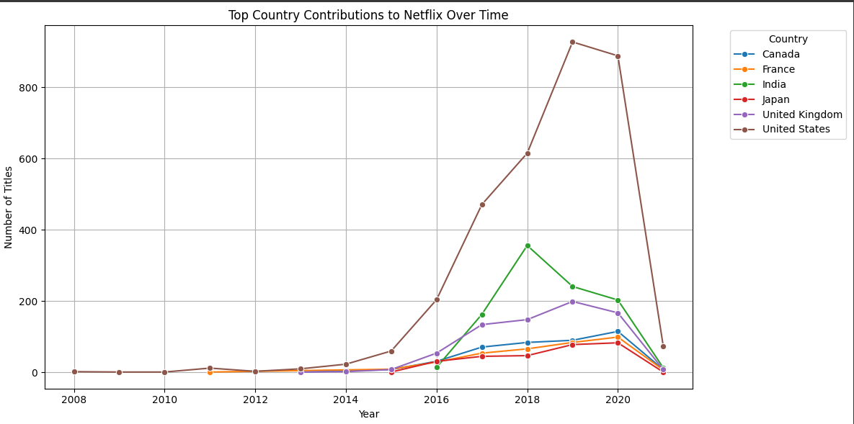
RESULTS2

Slide 8
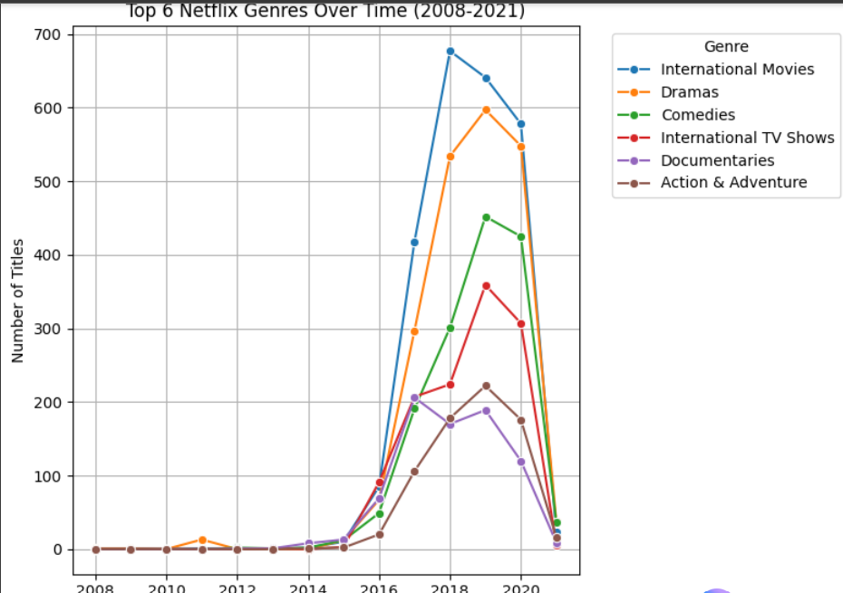
RESULTS3

Slide 9
GitHub repository
https://github.com/KhushiB03/VOIS_AICTE_Oct2025_MajorProject_KhushiBhardwaj

Slide 10
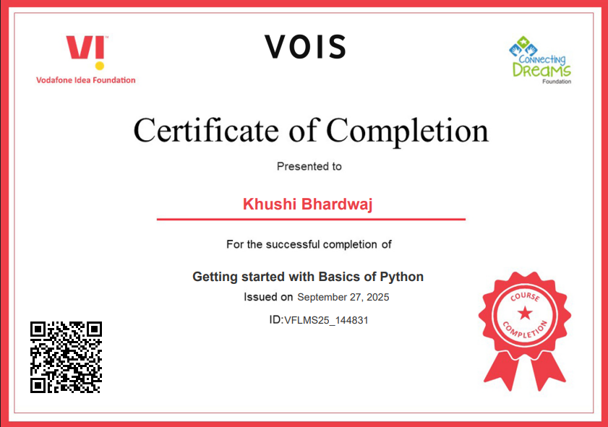
Getting started with Basics of Python Certificate
.

Slide 11
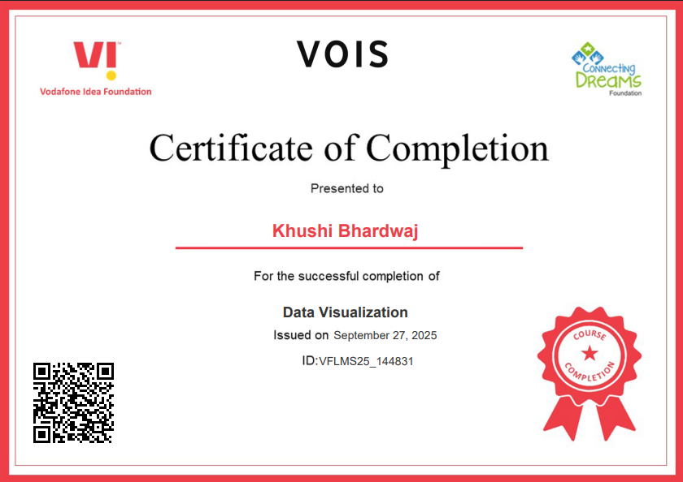
Data Visualization Certificate
.

Slide 12
Thank you
.
.

